Slide 1
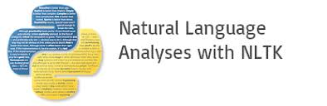

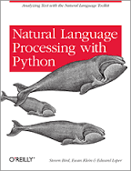
Introduction to Natural Language Processing
Year 2017

Slide 2

Learn NLP with Python videos
https://www.youtube.com/watch?v=FLZvOKSCkxY&list=PLQVvvaa0QuDf2JswnfiGkliBInZnIC4HL

Slide 3
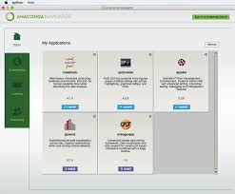
Installation Procedure
Visit the following page to install ANACONDA
https://docs.continuum.io/anaconda/install/
Click on ANACONDA navigator
Click on Jupyter launch
Click on new python file
In the working cell type
import nltk
nltk.download()
The above steps download all related NLTK package.
Start writing python codes and see how it is working

Slide 4
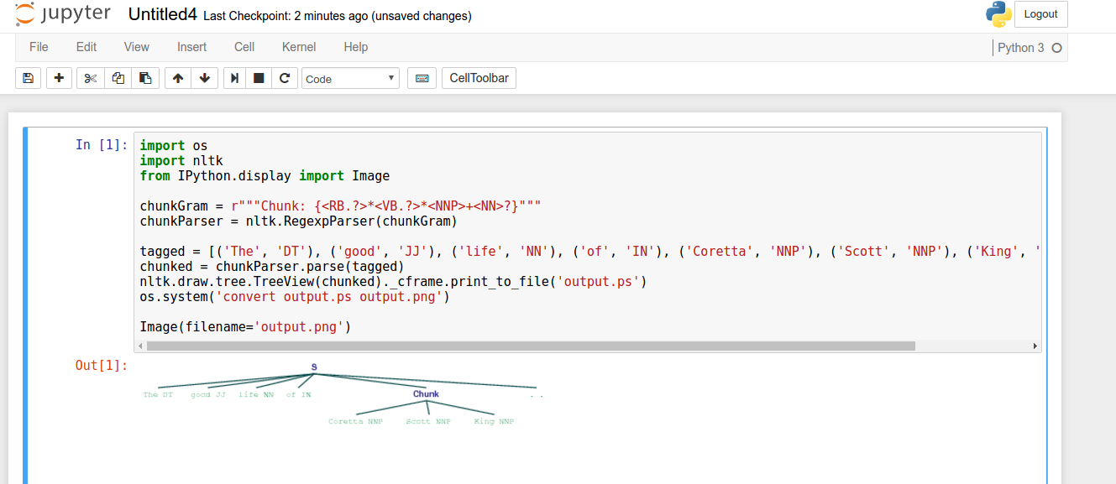
Jupyter Notebook

Slide 5
Introduction
Natural language processing (NLP) is the ability of a computer program to understand human speech as it is spoken. NLP is a component of artificial intelligence (AI).
Example for Natural Language
A human language. For example, English, French, and Chinese are natural languages. Computer languages, such as FORTRAN and C, are not. Probably the single most challenging problem in computer science is to develop computers that can understand natural languages.

Slide 6
NLTK
NLTK is a leading platform for building Python programs to work with human language data. It provides easy-to-use interfaces to over 50 corpora and lexical resources such as WordNet, along with a suite of text processing libraries for classification, tokenization, stemming, tagging, parsing, and semantic reasoning.

Slide 7
OpenNLP
The Apache OpenNLP library is a machine learning based toolkit for the processing of natural language text. It supports the most common NLP tasks, such as tokenization, sentence segmentation, part-of-speech tagging, named entity extraction, chunking, parsing, and coreference resolution.
https://opennlp.apache.org/

Slide 8
Introduction
Visit the following link to understand more on Natural Language Processing
https://blog.algorithmia.com/introduction-natural-language-processing-nlp/

Slide 9
NLP library by Facebook
If you put a status update on Facebook about purchasing a car – don’t be surprised if Facebook serves you a car ad on your screen. This is not black magic! This is Facebook leveraging the text data to serve you better ads.
https://www.analyticsvidhya.com/blog/2017/07/word-representations-text-classification-using-fasttext-nlp-facebook/?utm_source=feedburner&utm_medium=email&utm_campaign=Feed%3A+AnalyticsVidhya+%28Analytics+Vidhya%29

Slide 10
Sundar Pichai: How machine learning & deep learning improved technologies
Concepts | Subjects
Machine learning | SVM
Machine learning | Linear regression
Machine learning | Logistic regression
Machine learning | Polynomial regression
Machine learning | Decision trees
Machine learning | Random forest
Machine learning | Clustering
Neural networks | Multi layer perceptron
Neural networks | LSTM
Neural networks | GRU
Neural networks | Transformers
Neural netoworks | LLMs
Neural networks | Diffusion models
Reinforcement learning | Markov chain

Slide 11
Stanford NLP
Stanford NLP: a suite of NLP tools that provide part-of-speech tagging, the named entity recognizer, co-reference resolution system, sentiment analysis, and more.
https://stanfordnlp.github.io/CoreNLP/

